Slide 1
adapted from slides by Andrew Lih, WikiCite 2018, Licensed via CC-BY-SA 4.0

Slide 2
Wiki*
Wikipedia -- a multilingual web-based free-content encyclopedia
MediaWiki -- free and open-source wiki software
Wikidata.org -- a collaboratively edited structured dataset used by Wikimedia sister projects and others
Wikibase -- a MediaWiki extension to store and manage structured data

Slide 3
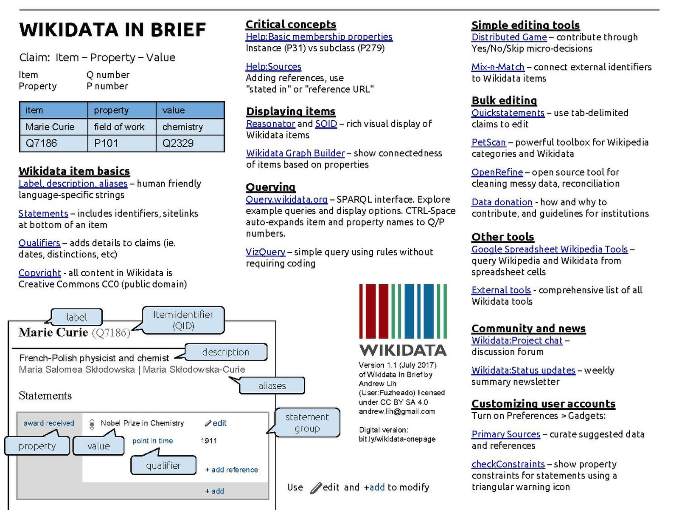

Slide 4
Wikipedia Today
More than 5.7 million English articles
Top 10 most visited site
High reputation and cultural partnerships
But
Knowledge scattered among 30 million articles in 200+ languages
Inconsistency, gaps and replication
How to consolidate knowable facts, e.g., birthdate of Barack Obama

Slide 5
Wikimedia lesson
2001: Images scattered across Wikipedia editions
2004: Wikimedia Commons centralized and consolidated multimedia objects
e.g., one standard image for Barack Obama that can be used across all of the pages about him in different Wikipedia instances
See https://en.wikipedia.org/wiki/Barack_Obama
See commons.wikimedia.org

Slide 6
Wikidata today
Wikidata used by
Google Knowledge Graph
Digital assistants: Siri, Alexa
Infoboxes on Wikipedia
Structured data on Commons
Wikicite, WikidataCon conferences

Slide 7
Wikidata future
Convert encyclopedic lexical content into "structured" statements
Turn human readable into machine understandable
Link to stable external data of LAM institutions
LAM = libraries, archives, and museums
"Semantic web" realized

Slide 8
Example entities and properties
Entities
Q1 – the universe
Q42 – douglas adams
Q59000000
Properties
P31 – instance of

Slide 9
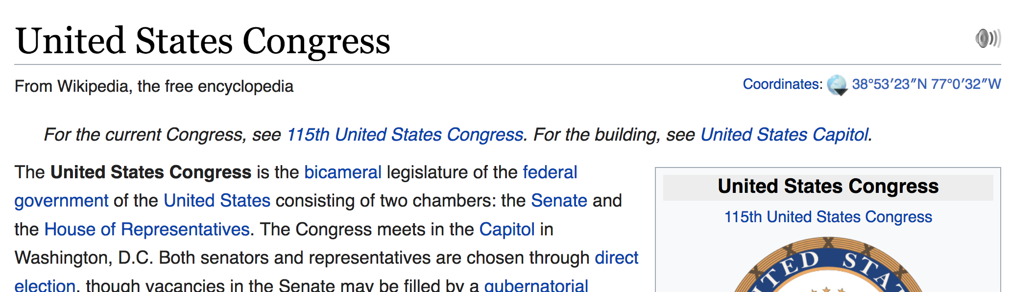
Moving to structured data
Lexical
United States Congress
instance of
bicameral legislature
Semantic
United States Congress
in country
United States
Notes:
In a typical Wikipedia article you'll see facts and figures in prose. There are infoboxes on the right side.

Slide 10
Moving to structured data
Lexical
United States Congress
instance of
bicameral legislature
Semantic
United States Congress
in country
United States
Notes:
In a typical Wikipedia article you'll see facts and figures in prose. There are infoboxes on the right side.

Slide 11
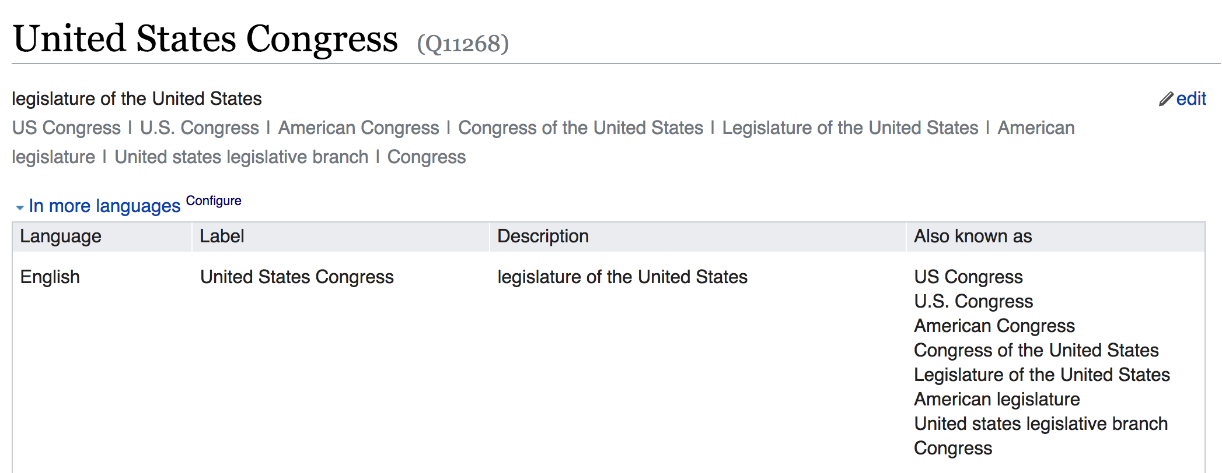
Wikidata item for United States Congress (Q11268)
Notes:
In a typical Wikipedia article you'll see facts and figures in prose. There are infoboxes on the right side.

Slide 12
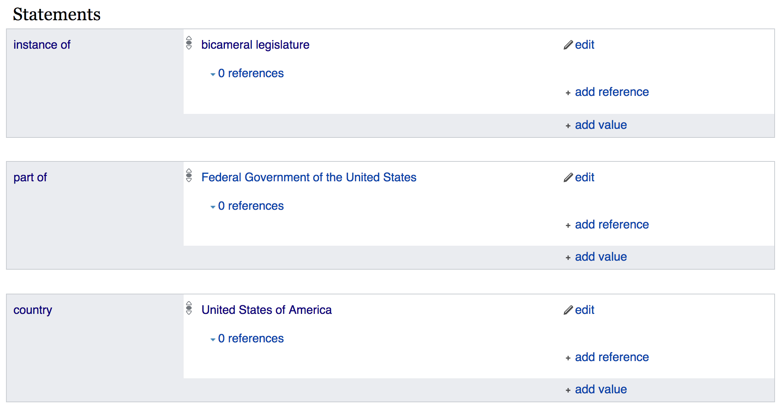
Wikidata item for United States Congress (Q11268)
Notes:
In a typical Wikipedia article you'll see facts and figures in prose. There are infoboxes on the right side.

Slide 13
Wikidata Basics
"Triple" item - property - value
Q numbers - item
Anyone can make a Q item
Corresponds to Wikipedia article / concept
Examples
Q1 - the Universe
Q2 - Earth
Q5 - human
Q146 - cat
Q729 - animal
Q571 - book
Q7075 - library
Q309331 - The Ohio State University
P numbers - property
Controlled vocabulary for consistency
Proposal, discussion and approval process
Examples
P31 - instance of
P279 - subclass of
P214 - VIAF ID
P569 - date of birth
P625 - coordinate location
See: Wikidata:List_of_properties

Slide 14
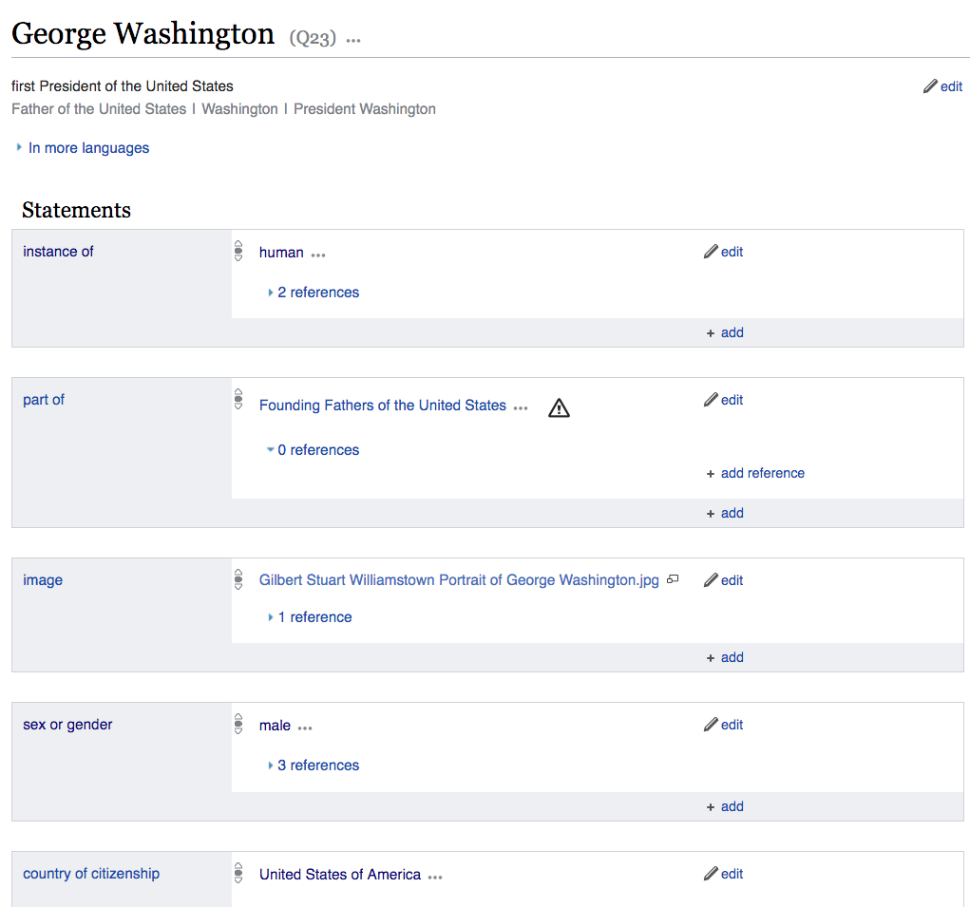
Wikidata item page
Claims capture factual, provable information
Any number of statements can be associated with an item

Slide 15
Wikidata statement triples
Item "George Washington"
Property "instance of"
Value "human"
Q23
P31
Q5
Underneath the surface...
Using symbols makes them language independent (identifiers vs names)
"George Washington"
"place of burial"
"Mount Vernon"
Q23
P119
Q731635
"George Washington"
"LCAuth ID"
"n86140996"
Q23
P244

Slide 16
Wikidata and languages
Labels and descriptions for different languages
Exciting for translation applications
zh 乔治·华盛顿
zh 性質
zh 人類
ms "George Washington"
ms "contoh"
ms "manusia"
es "George Washington"
es "instancia de"
es "ser humano"
de "George Washington"
de "ist ein(e)"
de "Mensch"
en "George Washington"
en "instance of"
en "human"
Q23
P31
Q5

Slide 17
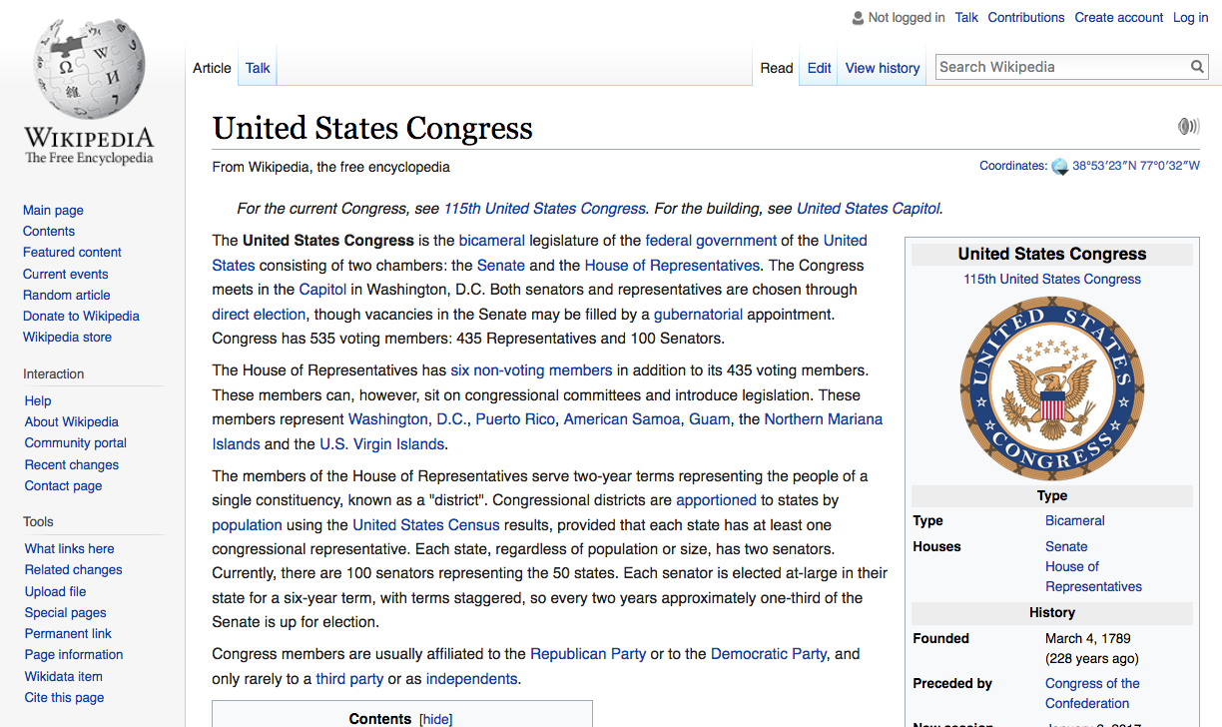
Wikidata link on Wikipedia articles

Slide 18

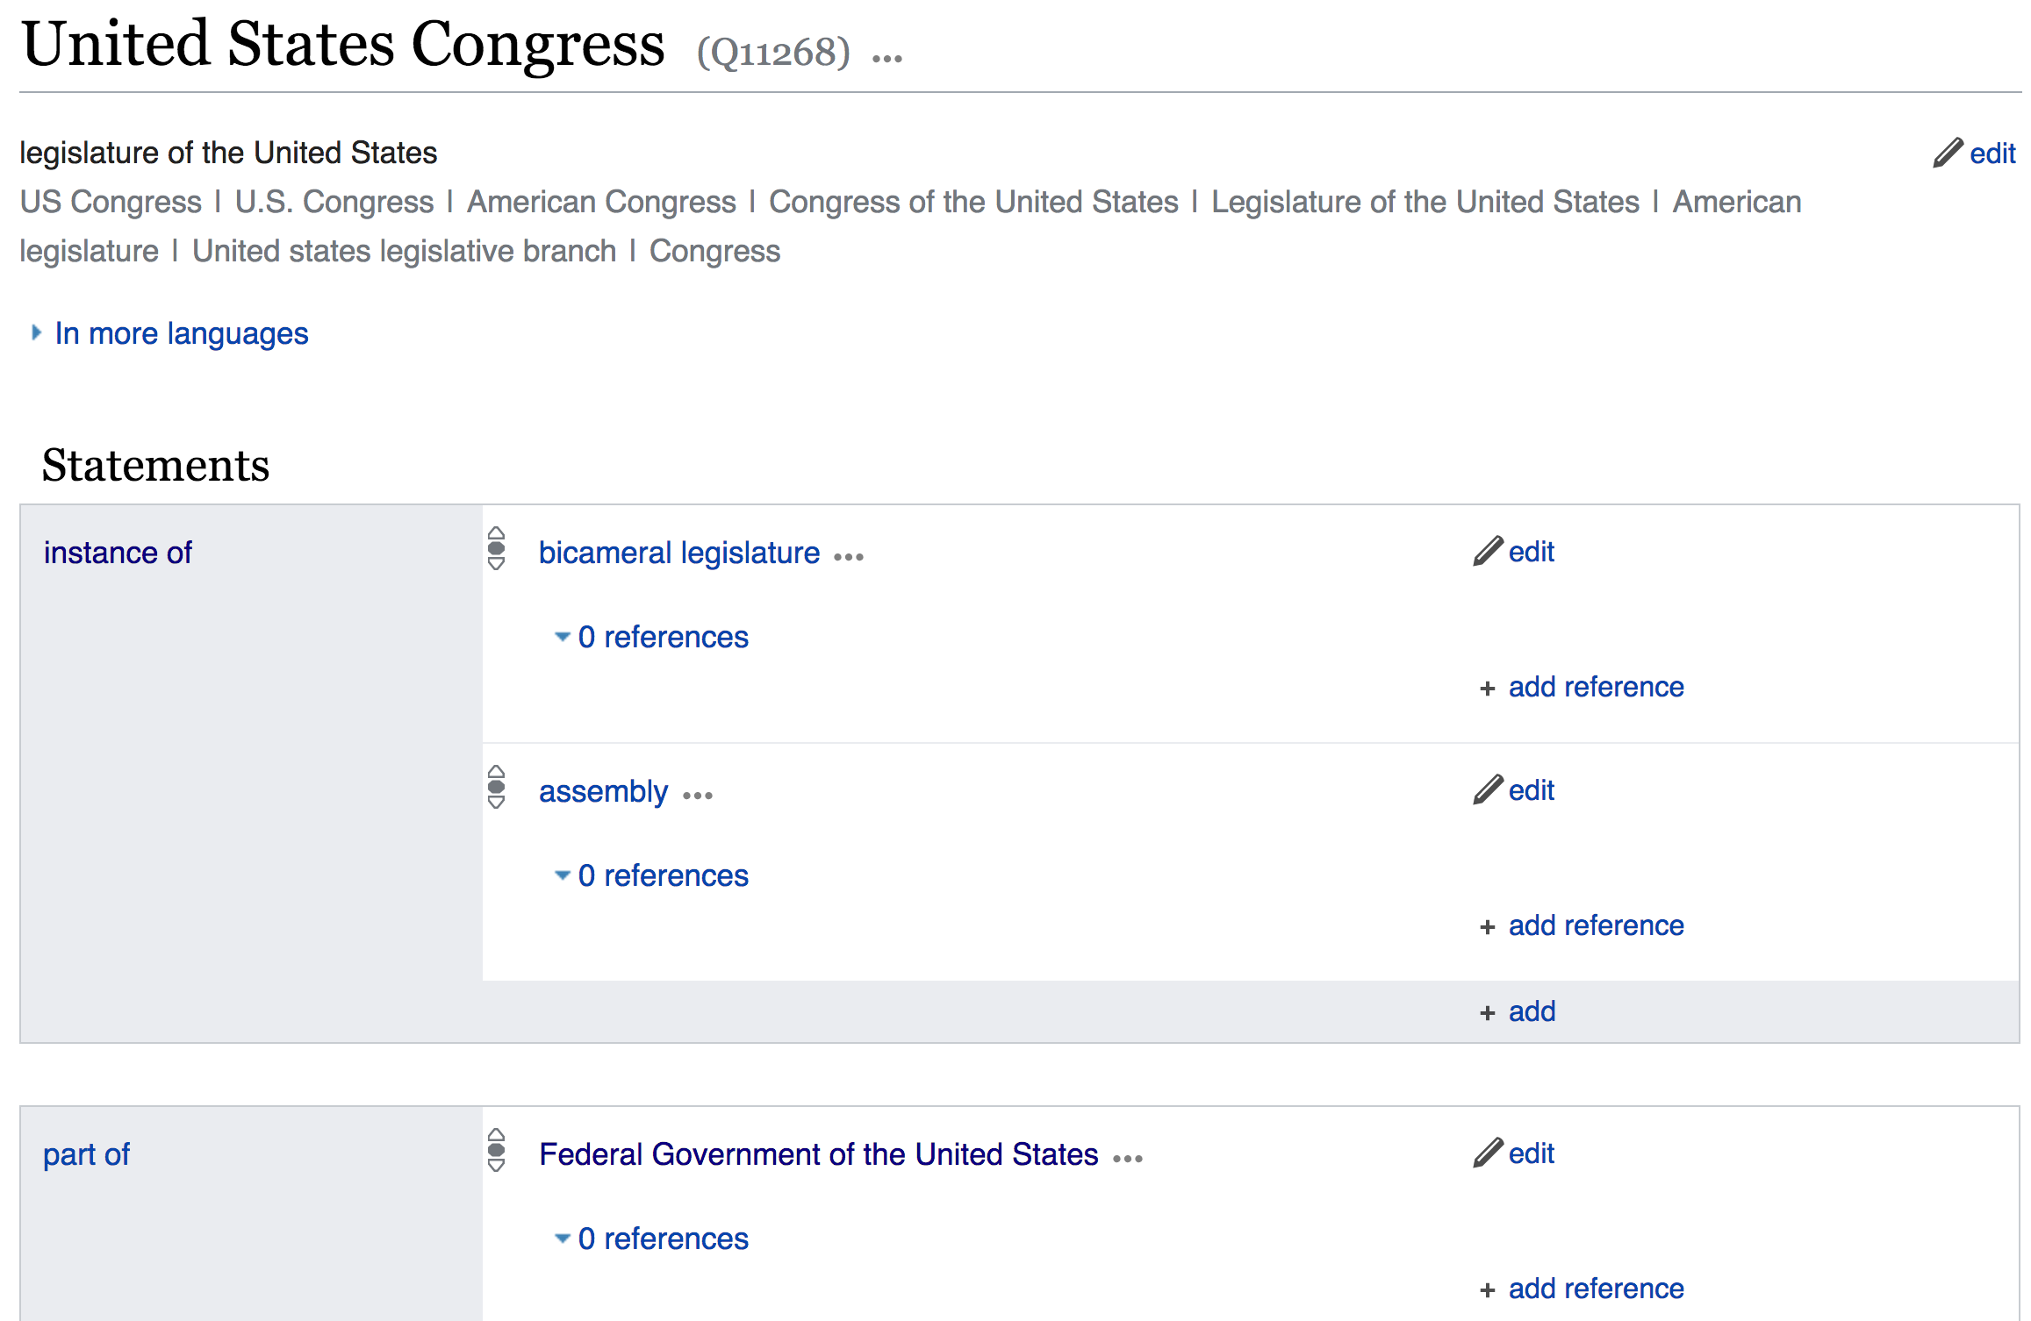
Wikidata stores statements as explicit triples - item + property + value
Item United States Congress
Q11268
Property "instance of"
Value "bicameral legislature"
P31
Q189445

Slide 19
Wikidata statement triples
Claims capture factual, provable information
Using symbols makes them language independent (identifiers vs names)
Item United States Congress
Property "instance of"
Value "bicameral legislature"
Q11268
P31
Q189445

Slide 20
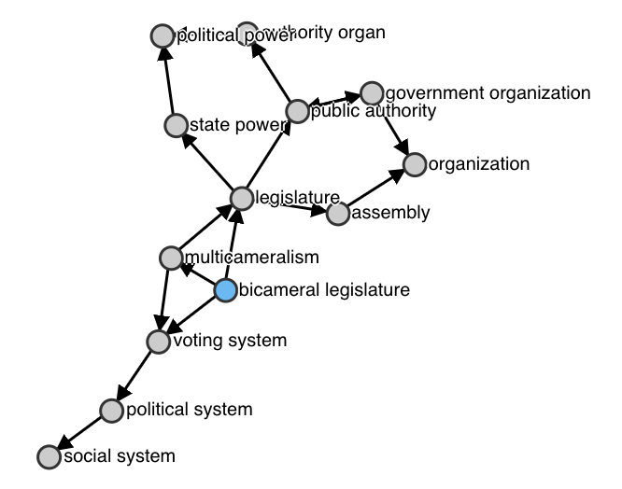
Wikidata statement triples
Relationships are "first class" = very fast to search and sort
Seconds vs minutes to search
Ad hoc data model highly adaptive
Well-suited to the wiki way
Item United States Congress
Property "instance of"
Value "bicameral legislature"
Q11268
P31
Q189445

Slide 21
Wikidata items
Muammar Gaddafi
Muammar Muhammad Abu Minyar al-Gaddafi
Colonel Gaddafi
Kadhafi
Mu‘ammar al Qaḏḏāfi
Moammar Al Qadhafi
Qaḏḏāfi
Gadafi
Kadaffi
Al-Khadafy
Gadaffi
Kaddafi
Muammar al–Gaddafi
Jaddafi
Qaddafy
Muammar Gaddafi
Muhamar Gadaffi
Mu‘ammar al-Qaḏḏafī
Al-Qadhdhaafi
Gadhafi
Qaḏḏafi
Qaḏḏāfī
Muammar Muhammad Abu Minyar al-Gaddafi
Khadafi
Mu‘ammar al-Qaḏḏāfi
Gaddafi
Muammar el Gadafi Muamar al-Gaddafi
Muamar al Gaddafi
Mu‘ammar al Qaḏḏafi
Kadafi
Omar Gadafi
Kaddaffi
Moammar Jaddafi
Muamar Gadafi
Muamar el-Gadafi
Mu‘ammar al Qaḏḏāfī
Al-Qathafi
Mu‘ammar al-Qaḏḏafi
Muamar al Gadafi
Moammar Gadafi
Muammar al-Gaddafi
Muhammad Ghadaffi
Muammar el Gaddafi
Muamar al Gaddafhi
Mu‘ammar al-Qaḏḏāfī
Mu‘ammar al Qaḏḏafī
Khaddafi
Muammar al Gaddafi
Qaḏḏafī
El Kazzafi
Muhamad Gadafi
Muamar al-Gaddafhi
Using identifiers removes language dependence and ambiguity in:
Writing systems (Chinese, Serbian, Kazakh, et al)
Phonetization variations
Spelling variations
Maiden vs. married names
Canonical identifiers help link to external databases
53 Latinized variations!
(May 2017)
Item Muammar Gaddafi
Q19878

